Slide 1
similarity in networks
Similarity measures and their applications

Slide 2
Three Measures of Similarity: Exercises
Jaccard coefficients
Hamming distance
Edit distance

Slide 3
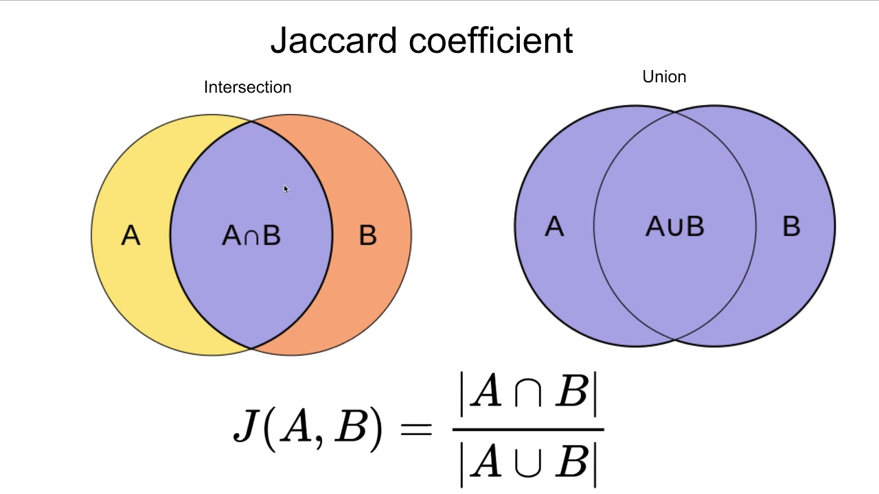

Jaccard Coefficients
Similarity between sets $A$ and $B$ is measured by the Jaccard coefficient $J(A,B)$: the more similar $A$ and $B$ are, the larger $J(A,B)$ is.

Slide 4
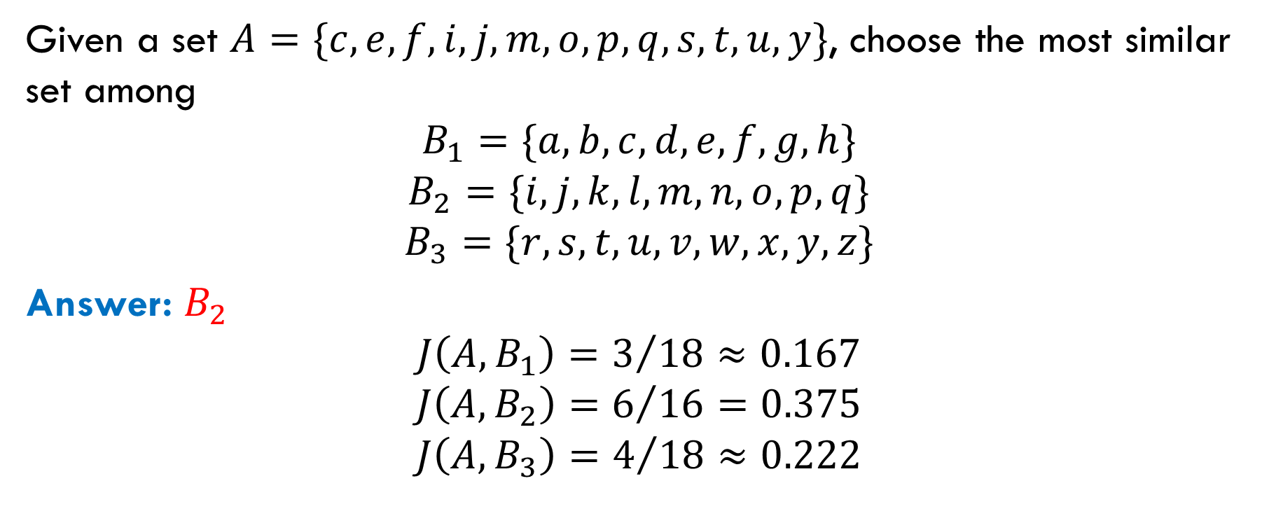
Exercise
Given a set $A=\{c, e, f, i, j, m, o, p, q, s, t, u,y\}$, choose the most similar set among
$$B_{1}=\{a, b, c, d, e, f, g, h\}$$
$$B_{2}=\{i, j, k, l, m, n, o, p, q\}$$
$$B_{3}=\{r, s, t, u, v, w, x, y, z\}$$
Answer: $B_{2}$
$$J\left(A, B_{1}\right)=3/{18}≈0.167$$
$$J\left(A, B_{2}\right)=6/{16=0.375}$$
$$J\left(A, B_{3}\right)=4/{18}≈0.222$$

Slide 5

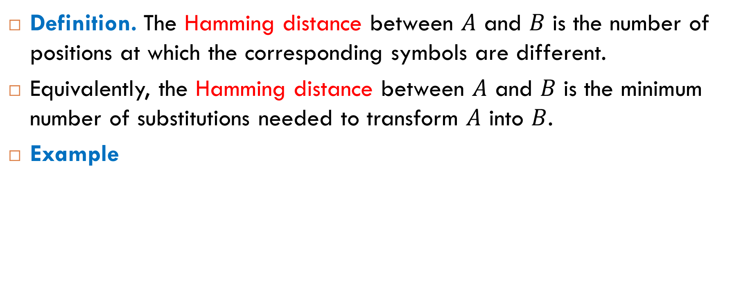
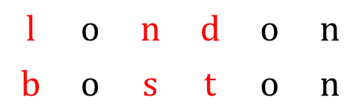
Hamming Distance
Definition. The Hamming distance between $A$ and $B$ is the number of positions at which the corresponding symbols are different.
Equivalently, the Hamming distance between $A$ and $B$ is the minimum number of substitutions needed to transform $A$ into $B$.
Example
$$\text{l}$$ | $$\text{o}$$ | $$\text{n}$$ | $$\text{d}$$ | $$\text{o}$$ | $$\text{n}$$
$$\text{b}$$ | $$\text{o}$$ | $$\text{s}$$ | $$\text{t}$$ | $$\text{o}$$ | $$\text{n}$$
$$H\left(\text{london},\text{boston}\right)=3$$

Slide 6
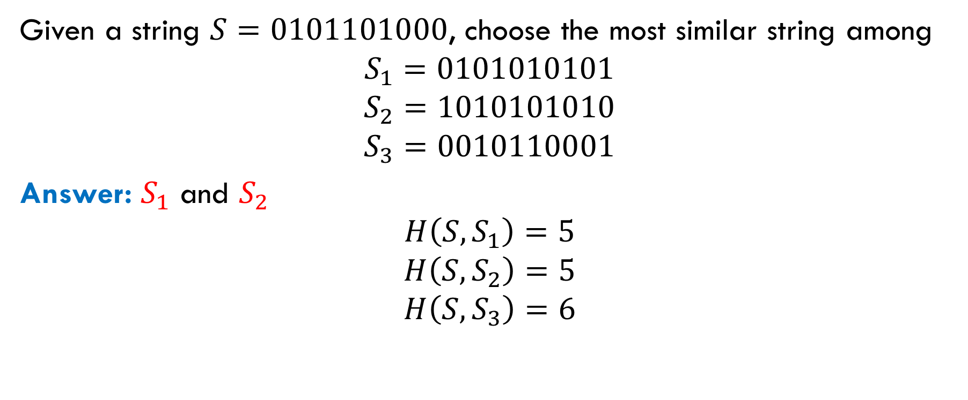
Exercise
Given a string $S=0101101000$, choose the most similar string among
$$S_{1}=0101010101$$
$$S_{2}=1010101010$$
$$S_{3}=0010110001$$
Answer: $S_{1}$ and $S_{2}$
$$H\left(S, S_{1}\right)=5$$
$$H\left(S, S_{2}\right)=5$$
$$H\left(S, S_{3}\right)=6$$

Slide 7
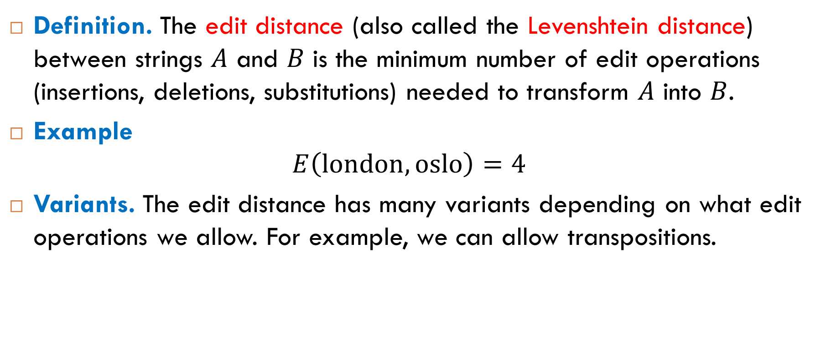
Edit Distance
Definition. The edit distance (also called the Levenshtein distance) between strings $A$ and $B$ is the minimum number of edit operations (insertions, deletions, substitutions) needed to transform $A$ into $B$.
Example
$$E\left(\text{london},\text{oslo}\right)=4$$
Variants. The edit distance has many variants depending on what edit operations we allow. For example, we can allow transpositions.

Slide 8
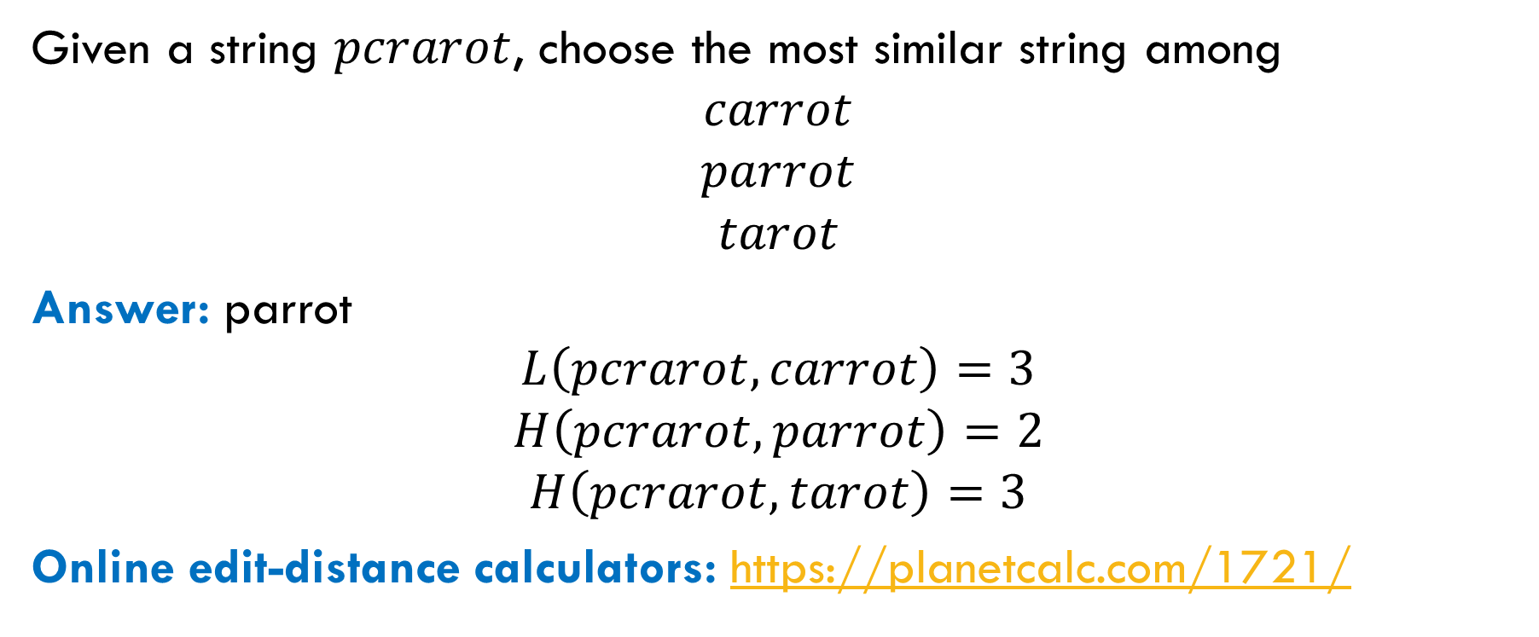
Exercise
Given a string $pcrarot$, choose the most similar string among
$$carrot$$
$$parrot$$
$$tarot$$
Answer: parrot
$$L\left(pcrarot, carrot\right)=3$$
$$H\left(pcrarot, parrot\right)=2$$
$$H\left(pcrarot, tarot\right)=3$$
Online edit-distance calculators: https://planetcalc.com/1721/

